Slide 1
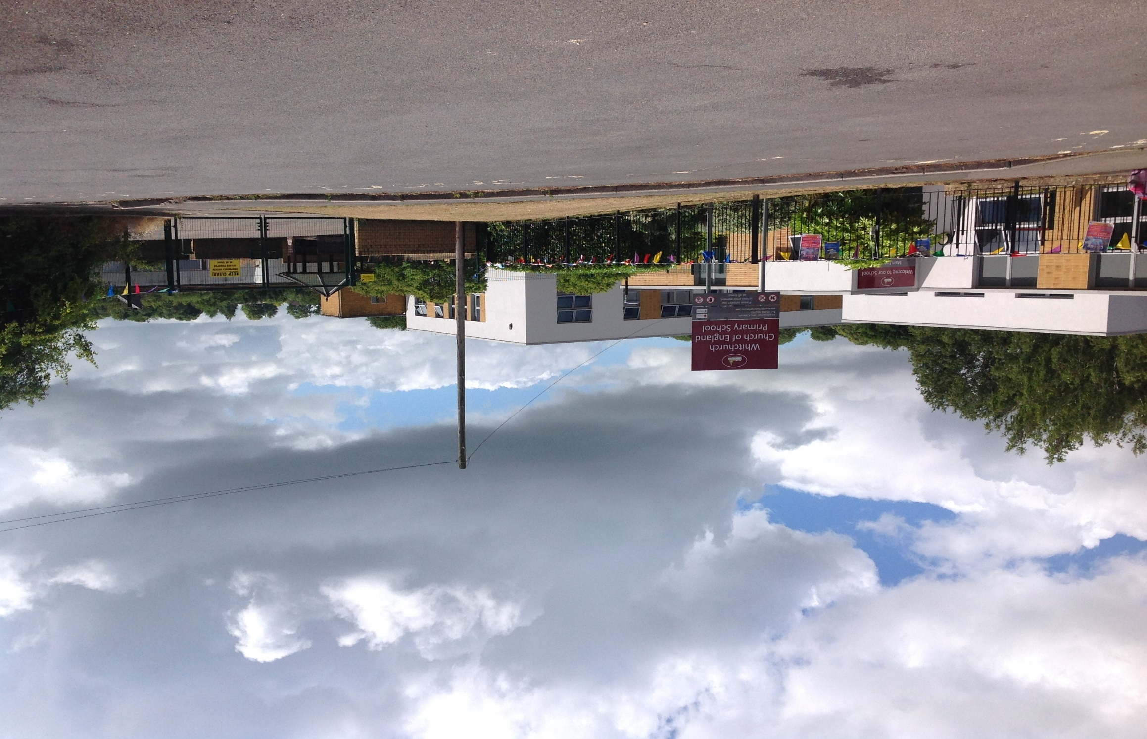
Welcome to Whitchurch Primary!
Here are some photos to help you learn more about our school and to help you become more familiar with your school surroundings.
This is our school entrance and school gates. In the morning you will come through these to start your day.

Slide 2
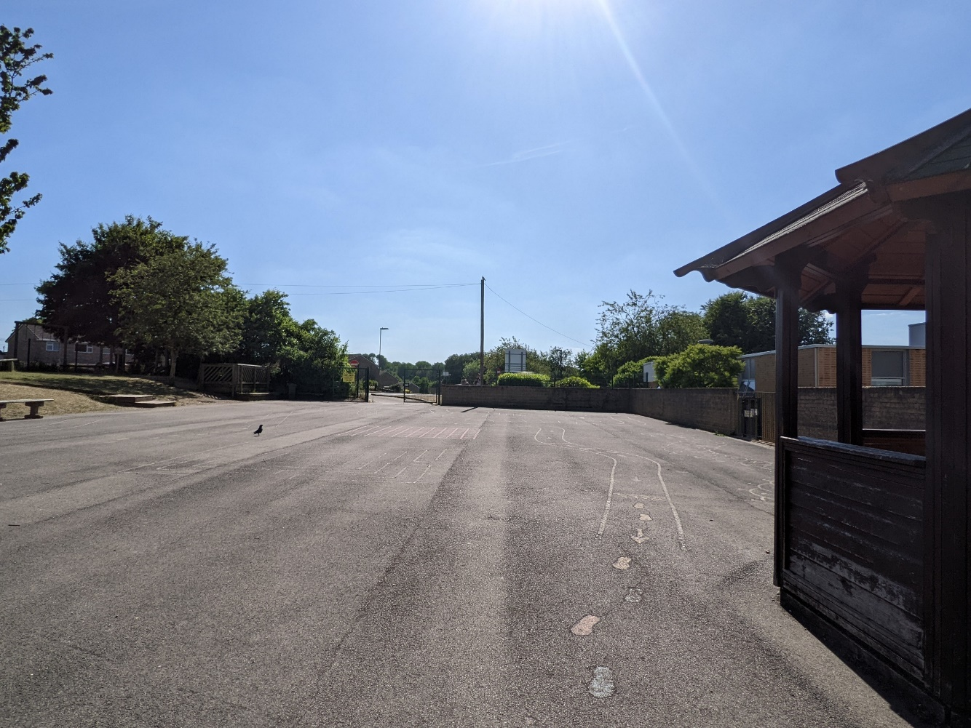
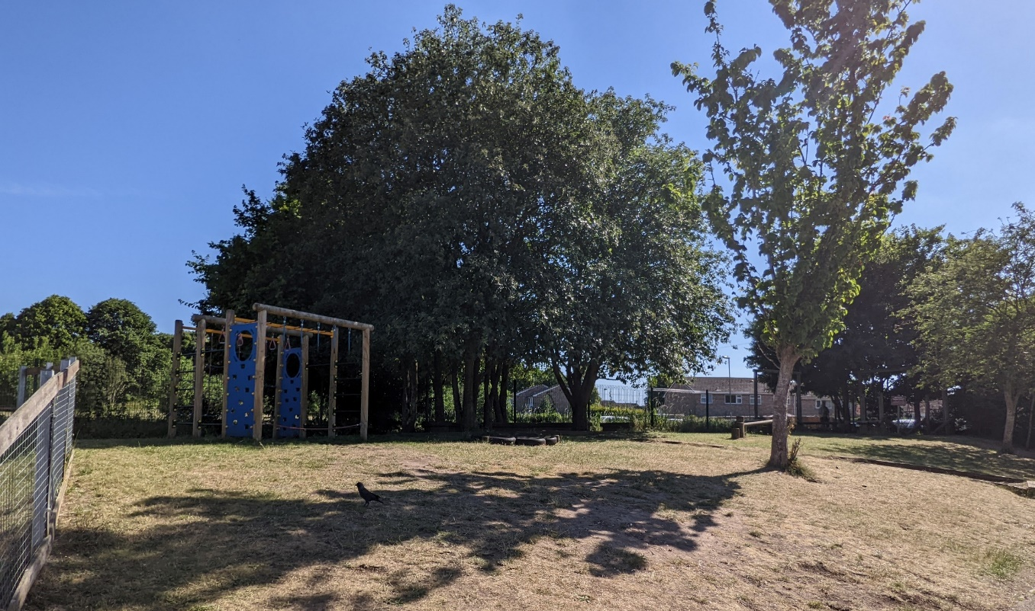
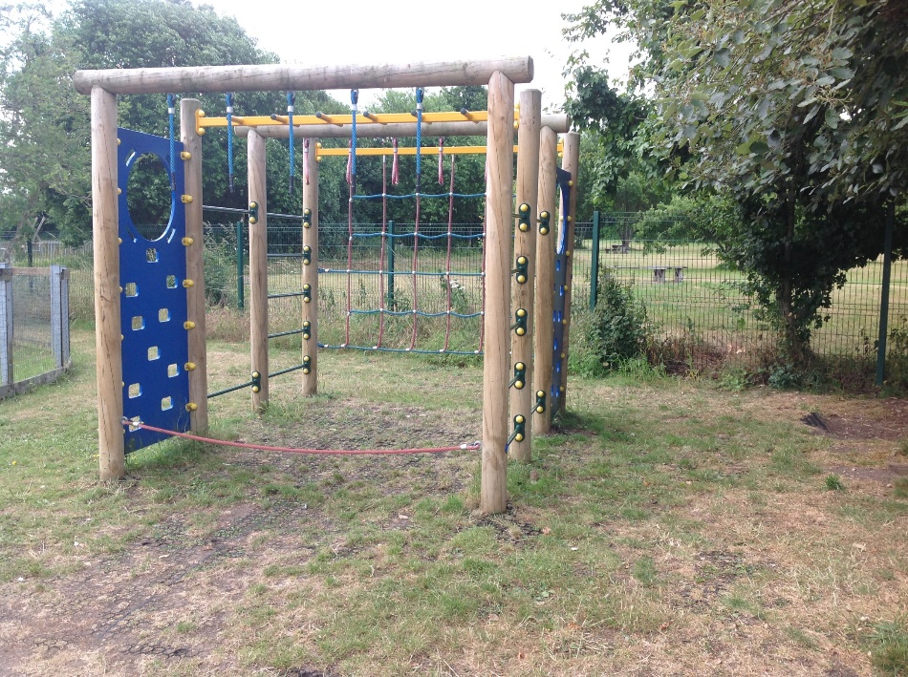
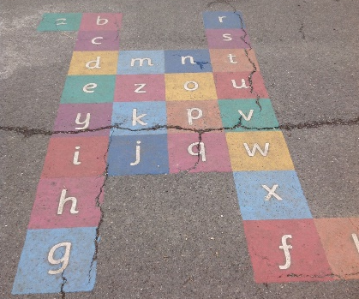
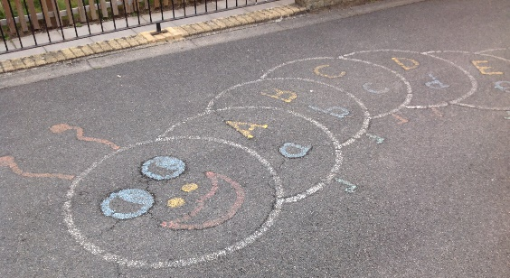
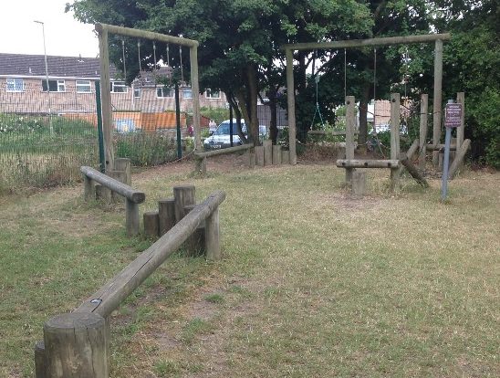
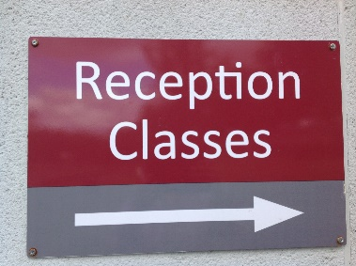
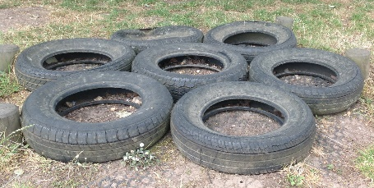
This is Key stage 1 playground and play area Year 1 and Year 2, Year R go up here in the summer term. Can you find the games painted on the playground floor? Can you find the sign that leads the way to your new Reception class?

Slide 3
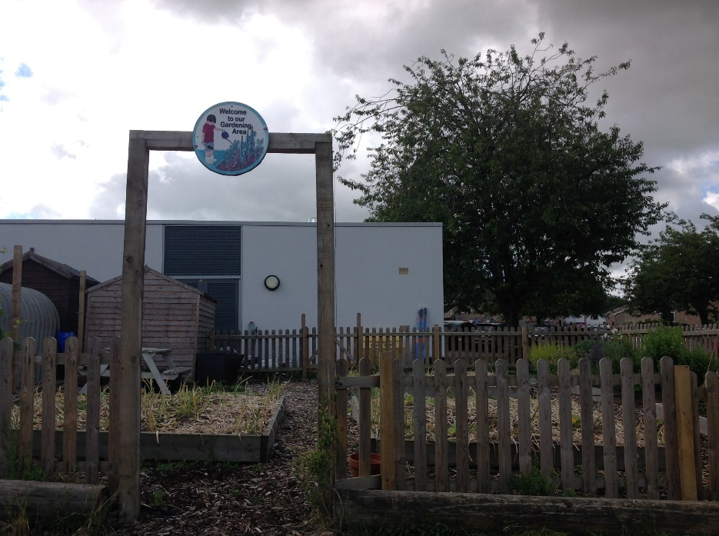
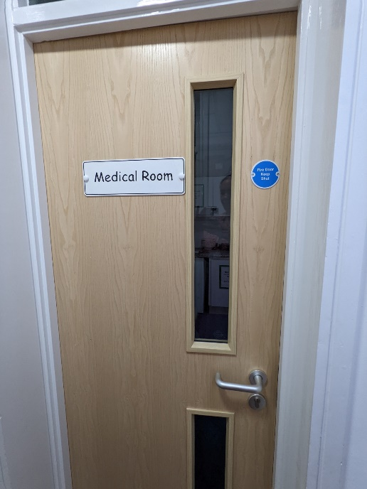
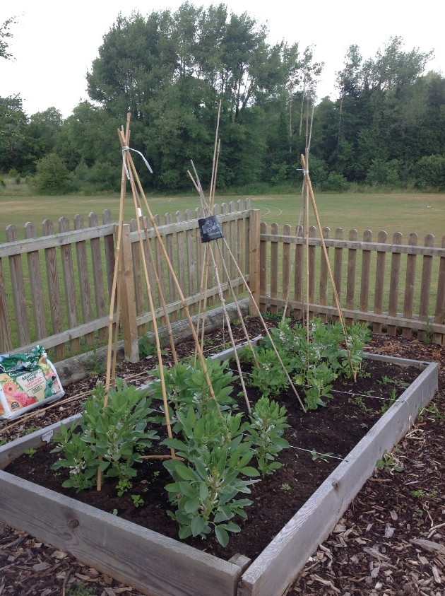
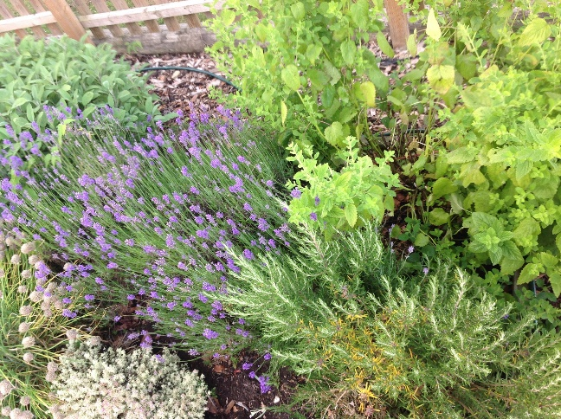
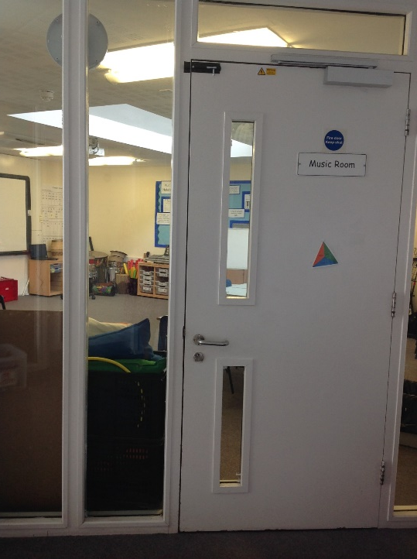
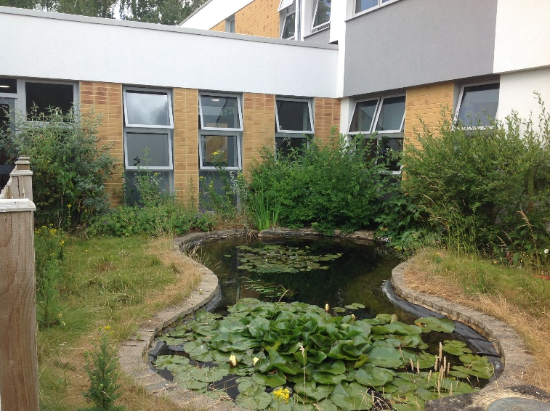
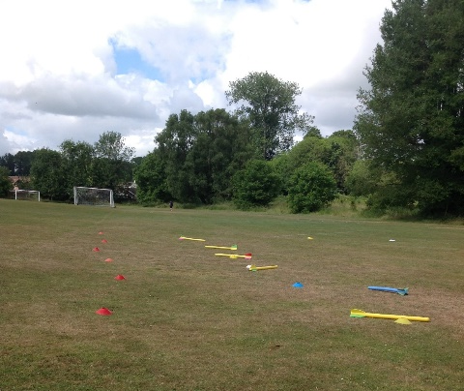
Other places around our school:
Our outside garden area.
Our school pond- watch out for the ducks who like to visit!
Our school field where we do PE lessons, sports day and lunchtime when the weather is warm.
Our medical room is where you will go if you feel sick or hurt yourself so someone can help you.
Our music room is where we have our music lessons.

Slide 4
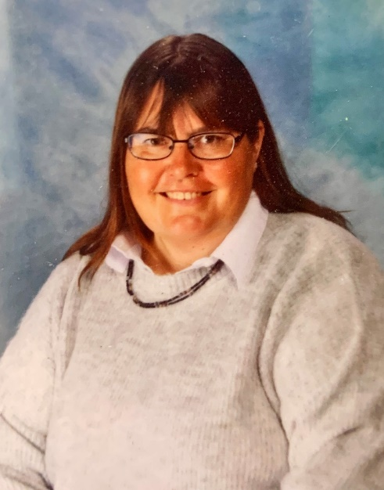
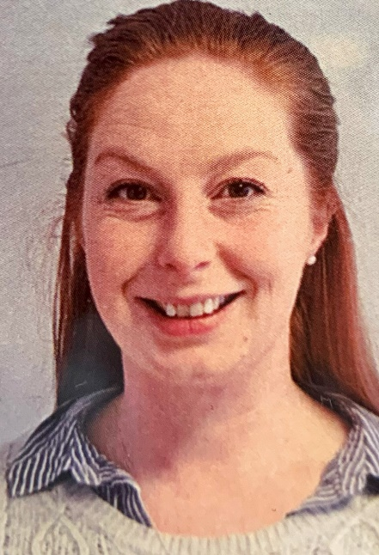
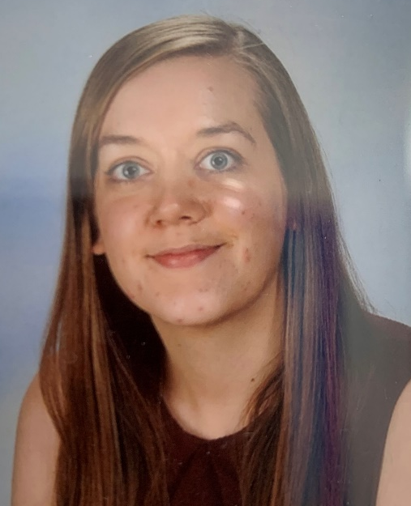
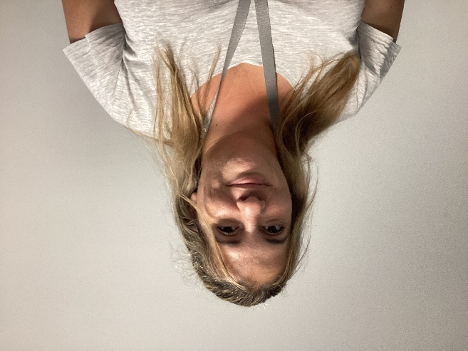
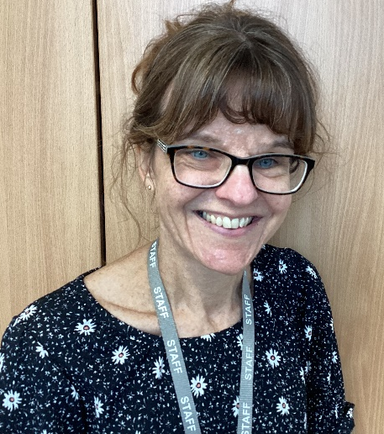
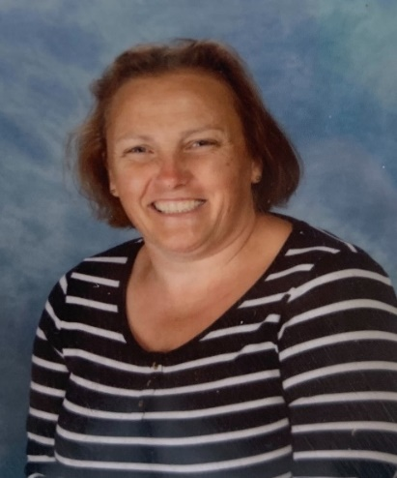
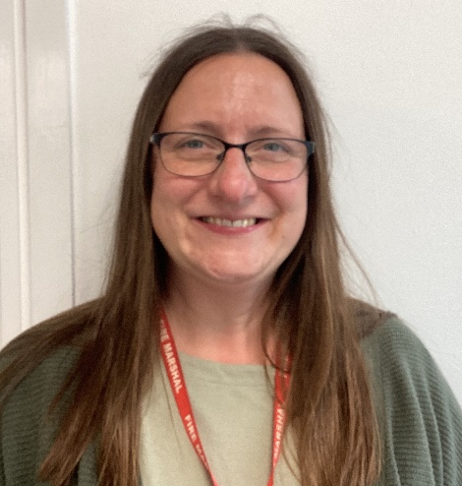
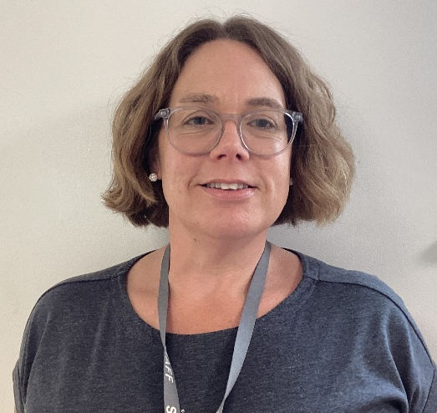
Our Reception Adults
This is Mrs Wersby. She is the Pelican Class teacher.
This is Mrs Fuller and Mrs Pearson. They are the Puffin Class Teachers.
Mrs Pearson
Miss Smith
Miss Coughtrey
Mrs Smeeton
Mrs Piper

Slide 5
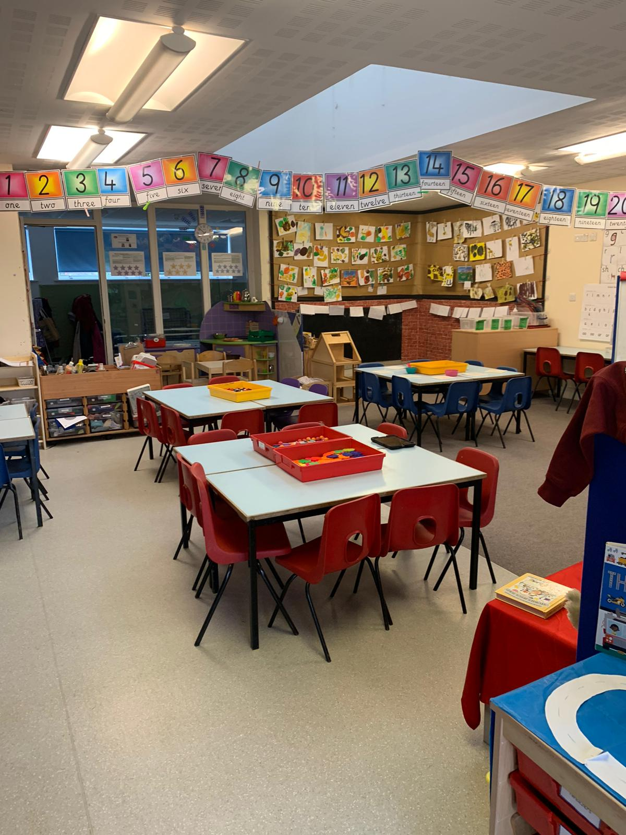
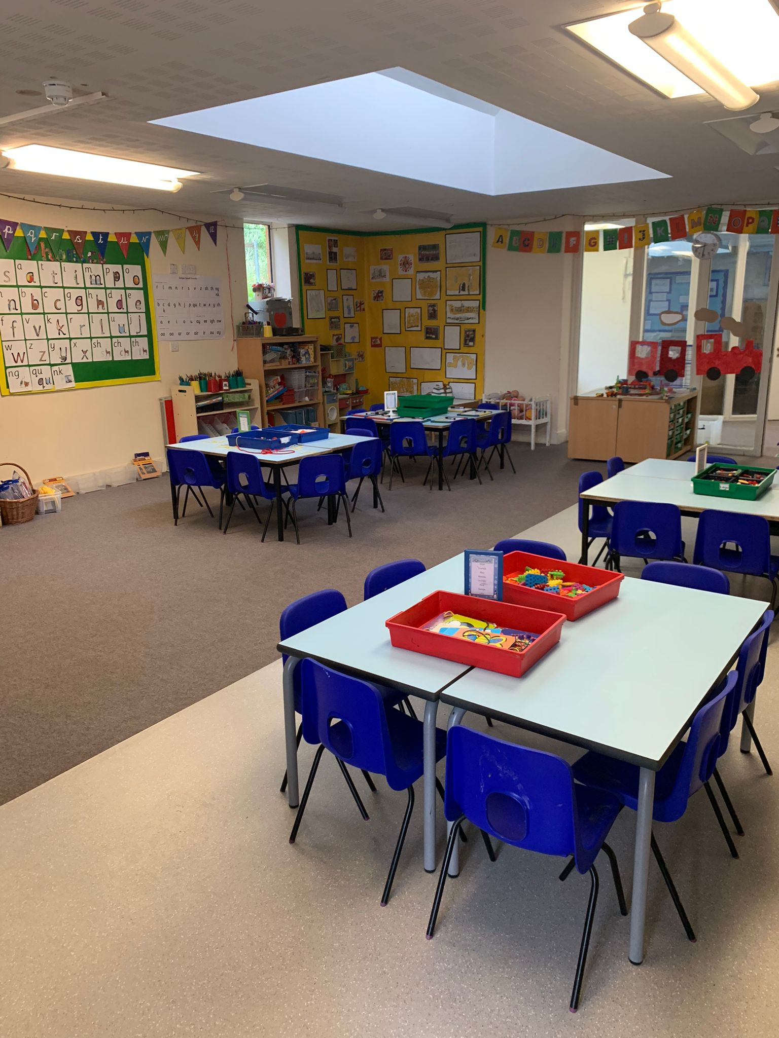
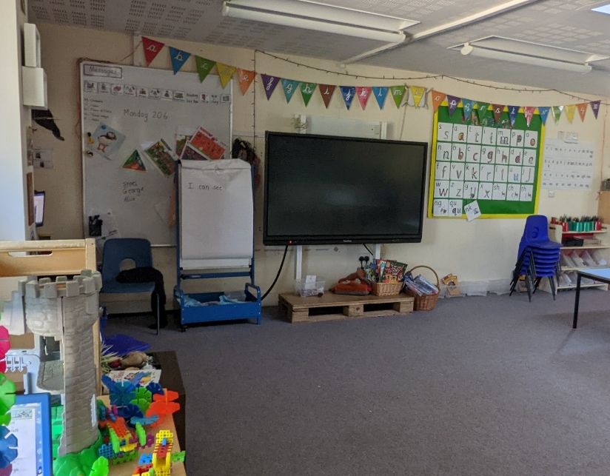
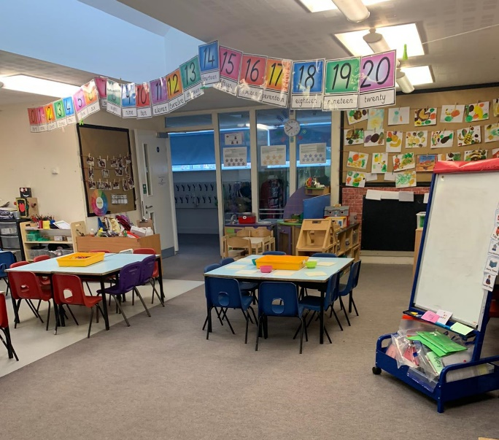
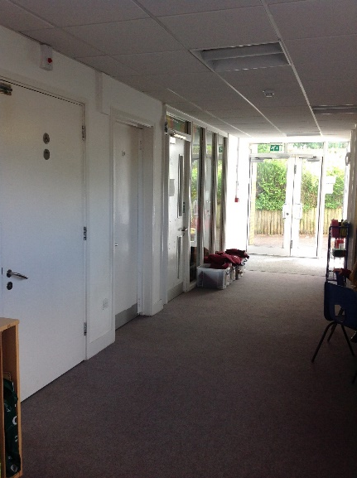
These are our Reception classrooms. They are called Pelican Class and Puffin Class.
In the corridor outside the classrooms is our toilet and our pegs where we hang our coats.

Slide 6
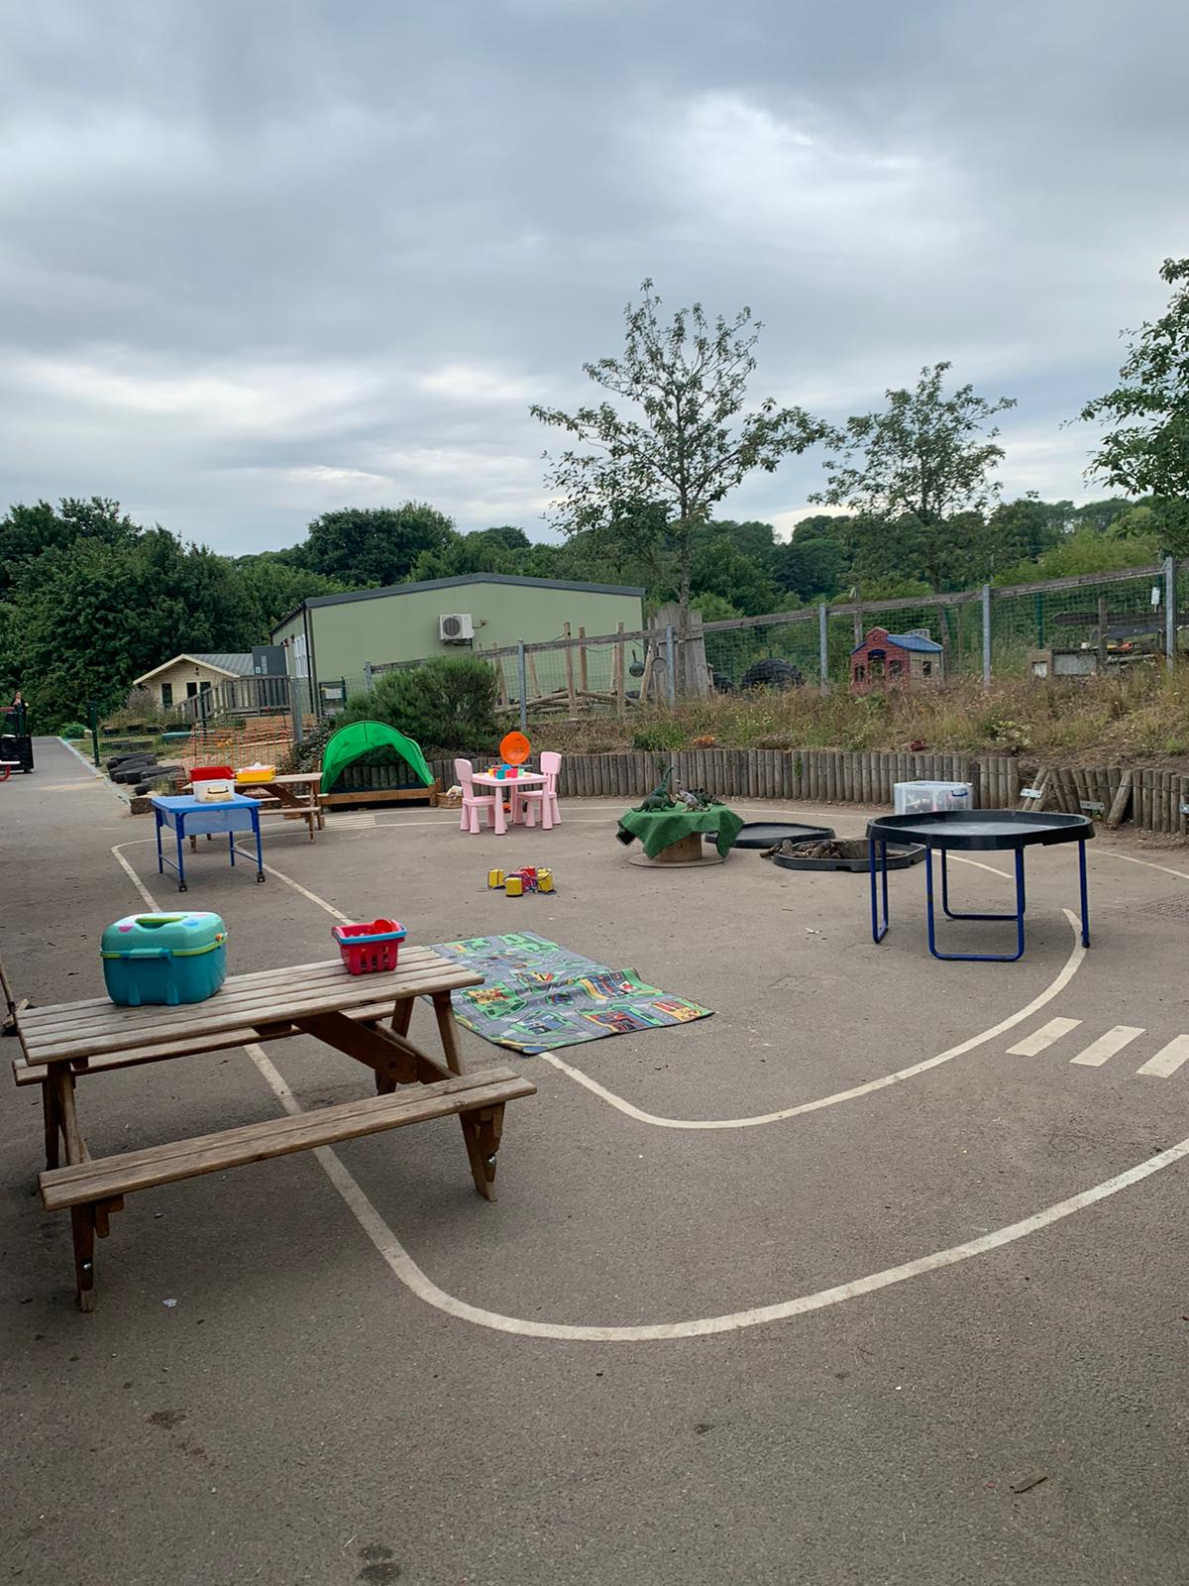
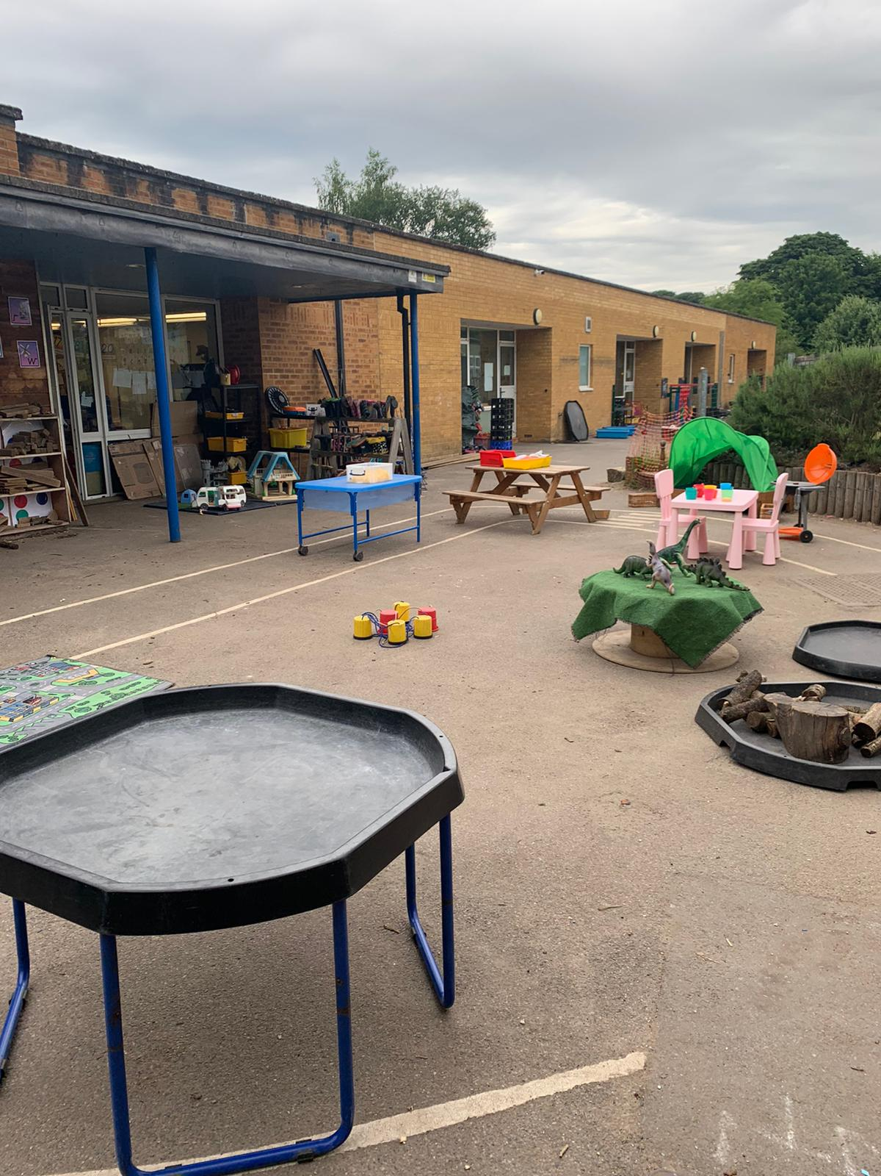
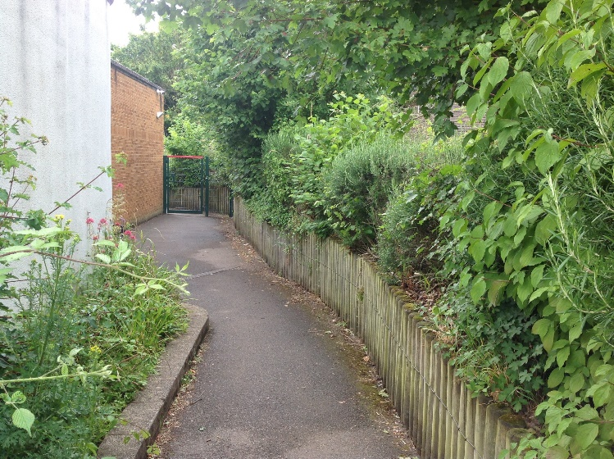
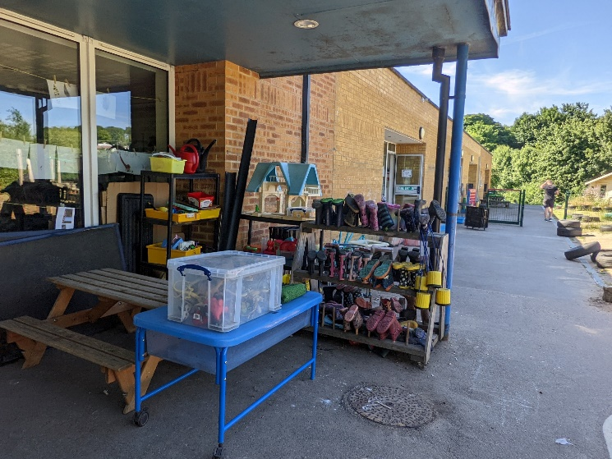
When you follow the ‘Reception classes’ sign on the playground, you will go down a path that will lead you to our outside play area.
This is our outside area for our Reception classes. There are lots of fun activities that we do in our outside area- messy play, outside kitchen and lots more! This is also where your adults will drop you off to class and pick you up after school from.

Slide 7
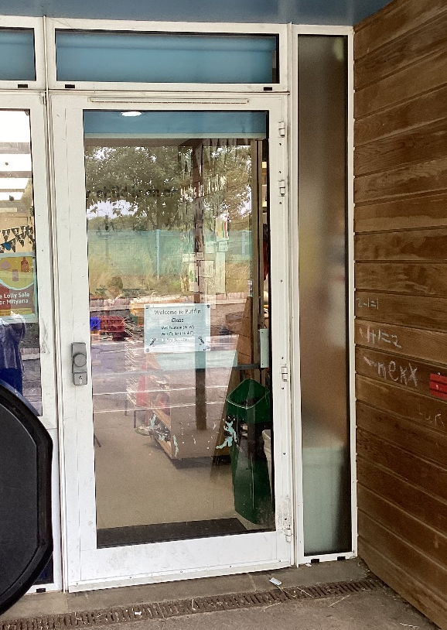
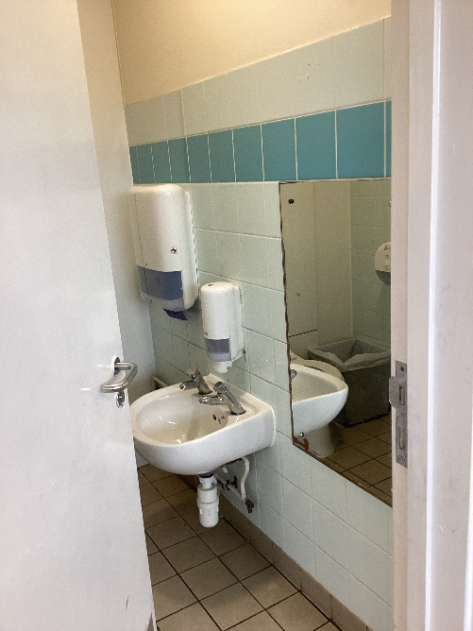
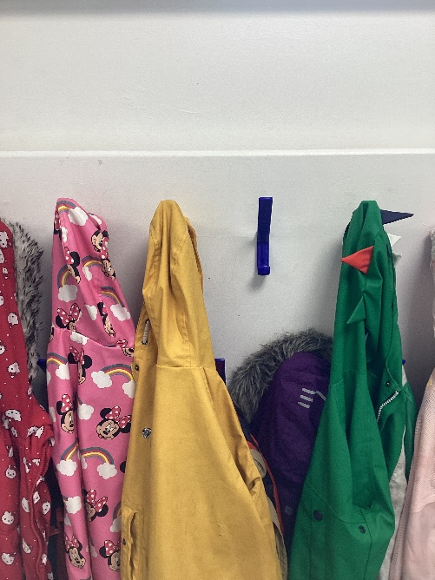
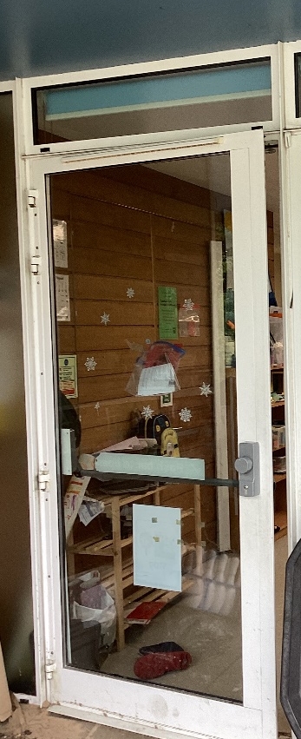
This is the toilet
This is where we hang our coats.
This is the door to Puffin class
This is the door to Pelican class

